Slide 1


Explainable query generation for cohort discovery and biomedical reasoning using natural language
Nic Dobbins
UW Biomedical Natural Language Processing Group
UW Medicine Research IT Department of Biomedical Informatics & Medical Education
University of Washington, Seattle, WA
June 20th, 2023

Slide 2
Outline
Introduction
Related Works
Aim 1 – Leaf Clinical Trials Corpus
Aim 2 – Query Generation
Aim 3 – Web Application
Conclusion

Slide 3

Introduction
Related Work
Clinical Trials Corpus
Query Generation
Web Application
Conclusions
Cohort Discovery
5.5m patients (EHR)
Process of finding patients meeting certain criteria relevant to a potential study
Often used in prep-to-research, hypothesis generation, power calculations, clinical trial recruitment, etc.
Can be done by manual chart review, electronic case report forms (eCRF), or queries of clinical databases
Over 65
Hypoglycemic
Left-handed
1,422 patients

Slide 4
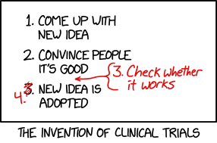
Introduction
Related Work
Clinical Trials Corpus
Query Generation
Web Application
Conclusions
Clinical Trials
Prospective study designed to determine whether an intervention (drug, device, etc.) is safe and effective
“Randomized” if participants randomly assigned to different groups
“Controlled” if includes a control group which does not receive intervention in question
Eligibility criteria – free-text descriptions of requirements
Inclusion – must meet
Exclusion – must not meet
Recognized as gold standard method for determining safety and efficacy of new treatments
https://xkcd.com/2530

Slide 5
Introduction
Related Work
Clinical Trials Corpus
Query Generation
Web Application
Conclusions
Clinical Trials - challenges
Expensive – between 2004 & 2016, mean costs:
Phase I: $3.8m
Phase II: $13.3m
Phase III: $19.8m
Finding eligible patients time-consuming and costly
Eligibility criteria often complex
Patients recruited tend to be
From ethnic majorities
More affluent than affected populations at large
Sources:
-Sertkaya, Aylin, et al. "Key cost drivers of pharmaceutical clinical trials in the United States." Clinical Trials 13.2 (2016): 117-126.
-G. Frank. Current challenges in clinical trial patient recruitment and enrollment. SoCRA Source, 2(February):30–38, 2004.
-C. Heller, J. E. Balls-Berry, J. D. Nery, P. J. Erwin, D. Littleton, M. Kim, and W. P. Kuo. Strategies addressing barriers to clinical trial enrollment of underrepresented populations: a systematic review. Contemporary clinical trials, 39(2):169–182, 2014.

Slide 6
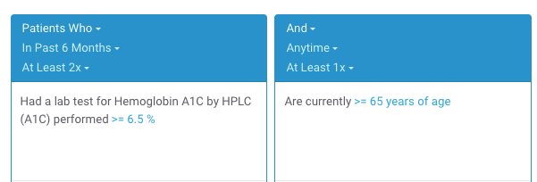
Introduction
Related Work
Clinical Trials Corpus
Query Generation
Web Application
Conclusions
Clinical Trials Recruitment and (Cohort Discovery) Software
Computer software cannot solve all challenges
However, can sometimes reduce manual workloads and save time/costs related to recruitment
Existing cohort discovery tools can be used by manually translating free-text eligibility criteria into database queries
“- At least 2 A1c tests > 6.5%
- 65+ y/o”
2,273 patients found
Example Leaf query.
Sources:
-Johnson, Emilie K., et al. "Use of the i2b2 research query tool to conduct a matched case–control clinical research study: advantages, disadvantages and methodological considerations." BMC medical research methodology 14.1 (2014): -L. Penberthy, R. Brown, F. Puma, and B. Dahman. Automated matching software for clinical trials eligibility: measuring efficiency and flexibility. Contemporary clinical trials, 31(3):207–217, 2010.
-S. R. Thadani, C. Weng, J. T. Bigger, J. F. Ennever, and D. Wajngurt. Electronic screening improves efficiency in clinical trial recruitment. Journal of the American Medical Informatics Association, 16(6):869–873, 2009.

Slide 7
Introduction
Related Work
Clinical Trials Corpus
Query Generation
Web Application
Conclusions
Clinical Trials Recruitment and (Cohort Discovery) Software
Existing drag-and-drop cohort discovery tools are not a panacea:
⨯ Significant learning curves
⨯ Visual representation of data discordant with “mental maps” of how data are collected or stored
⨯ May be structurally unable to represent certain complex criteria or sequences of events

Slide 8
Introduction
Related Work
Clinical Trials Corpus
Query Generation
Web Application
Conclusions
Clinical Trials Recruitment and Natural Language Processing (NLP)
Alternatively, using NLP to automatically analyze free-text eligibility criteria and find patients has appeal
Researchers are accustomed to writing criteria using natural language
No (or less) need to learn special tools
“- At least 2 A1c tests > 6.5%
- 65+ y/o”
NLP
2,273 patients found

Slide 9
Introduction
Related Work
Clinical Trials Corpus
Query Generation
Web Application
Conclusions
Challenges
What kind of surgery?
When is “newly”?
1. Newly diagnosed with breast cancer and scheduled for surgery
2. 18 years or above
3. Those who experience high psychological stress will enter the trial whereas those with low stress will be followed in an observational questionnaire study
4. No severe psychiatric disease requiring treatment, e.g., schizophrenia
What is 18 years or above?
Statement of fact, not a criterion
What could these be?
Many of these relate to reasoning. Also: acronyms, misspellings, etc.
Adapted from trial NCT03254875 at https://clinicaltrials.gov/ct2/show/NCT03254875

Slide 10


Introduction
Related Work
Clinical Trials Corpus
Query Generation
Web Application
Conclusions
Project Goals
Aim 1
Aim 2
Aim 3
Create a human-annotated gold standard corpus of eligibility criteria.
Develop state-of-the-art NLP-based methods for generating SQL queries for cohort discovery from free-text.
Develop self-service web application for finding patients meeting user-provided free-text eligibility criteria.
“Patients with ...”
SELECT FROM...

Slide 11
Introduction
Related Work
Clinical Trials Corpus
Query Generation
Web Application
Conclusions
Broader Impact
May reduce cost + labor burden of finding patients for clinical trials
NLP methods for cohort discovery may be useful for other kinds of biomedical research, e.g.,
Question answering
Information extraction
Evaluating system performance by comparing patients found to those enrolled in trials (Aim 2)
Novel
Significantly raises standards for this task

Slide 12
Introduction
Related Work
Clinical Trials Corpus
Query Generation
Web Application
Conclusions
Related Work
Corpora of eligibility criteria
Methods for query generation from free-text criteria
NLP-based software for cohort discovery

Slide 13
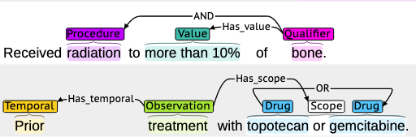
Introduction
Related Work
Clinical Trials Corpus
Query Generation
Web Application
Conclusions
Aim 1 - Corpora of Eligibility Criteria
EliXR by Weng et al. (2011)
1,000 eligibility criteria documents
Various disease domains, custom schema
Not publicly available
EliIE by Kang et al. (2017)
230 eligibility criteria documents related to Alzheimer's Disease
Annotation schema based on the OMOP database schema
Chia by Kury et al. (2020)
1,000 eligibility criteria documents
Various disease domains
Based on OMOP database schema
Example Chia annotation.
Sources:
-C. Weng, X. Wu, Z. Luo, M. R. Boland, D. Theodoratos, and S. B. Johnson. EliXR: an approach to eligibility criteria extraction and representation. Journal of the American Medical Informatics Association, 18. Dec 2011. -T. Kang, S. Zhang, Y. Tang, G. W. Hruby, A. Rusanov, N. Elhadad, and C. Weng. EliIE: An open-source information extraction system for clinical trial eligibility criteria. JAMIA, 24(6):1062–1071, 2017. -F. Kury, A. Butler, C. Yuan, L.-h. Fu, Y. Sun, H. Liu, I. Sim, S. Carini, and C. Weng. Chia, a large annotated corpus of clinical trial eligibility criteria. Scientific data, 7(1):1–11, 2020.

Slide 14
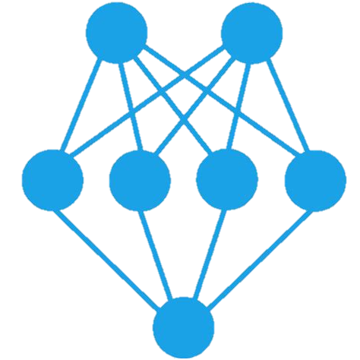
Introduction
Related Work
Clinical Trials Corpus
Query Generation
Web Application
Conclusions
Aim 2 - Database Query Generation
“Hemoglobin A1c > 6.5%”
Extensive recent Seq2Seq work using text-to-SQL generation with Encoder-Decoder Transformer architectures.
Tend to fall short by some combination of
Only generating queries for single data model
Assuming user utterances map directly to table/column names
Accurate queries dependent on specific data/codes in database (unknown to the model or normalization failures)
SELECT patient_id
FROM labs
WHERE lab_type = ‘a1c’
AND value > 6.5
Sources:
-Kulkarni, Pranav, et al. "Text2Cohort: Democratizing the NCI Imaging Data Commons with Natural Language Cohort Discovery." arXiv preprint arXiv:2305.07637 (2023)
-S. Bae, D. Kim, J. Kim, and E. Choi. Question Answering for Complex Electronic Health Records Database using Unified Encoder-Decoder Architecture. In Machine Learning for Health, pages 13–25. PMLR, 2021.
-P. Wang, T. Shi, and C. K. Reddy. Text-to-SQL generation for question answering on electronic medical records. In Proceedings of The Web Conference 2020, pages 350–361, 2020. -Y. Pan, C. Wang, B. Hu, Y. Xiang, X. Wang, Q. Chen, J. Chen, J. Du, et al. A BERT-Based Generation Model to Transform Medical Texts to SQL Queries for Electronic Medical Records: Model Development and Validation. JMIR Medical Informatics, 9(12):e32698, 2021.
-Yu, Xiaojing, et al. "Dataset and enhanced model for eligibility criteria-to-SQL semantic parsing." 12th International Conference on Language Resources and Evaluation (LREC). 2020.

Slide 15




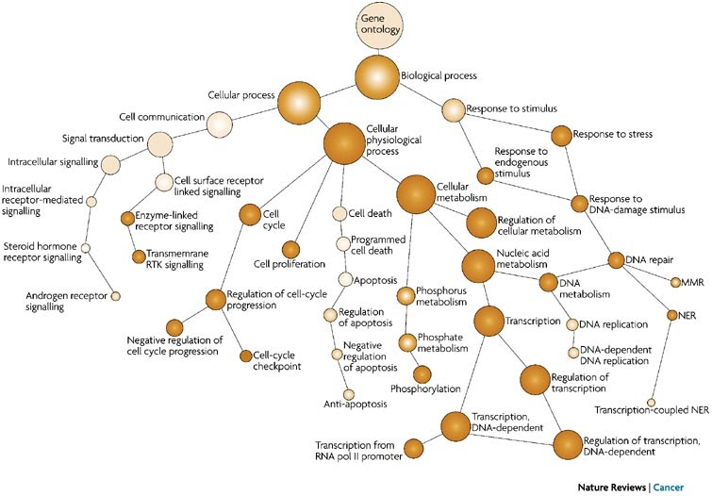
Introduction
Related Work
Clinical Trials Corpus
Query Generation
Web Application
Conclusions
Other notable approaches
Document Ranking and Classification
Clinical notes sorted by those meeting criteria
Various architectures (Chen et al.: biLSTM+CRF, Soni and Roberts: BERT)
Embeddings and similarity measurement
Eligibility criteria and patient medical history represented as vectorized embeddings
Compare by cosine similarity or as entailment problem (ie, patient history entails criteria = { true, false, unknowable })
Logical representations and ontologies
Graphs, OWL reasoners to predict eligibility
Various logical annotation representations for eligibility criteria using First Order Logic, etc.
Sources:
-L. Chen, Y. Gu, X. Ji, C. Lou, Z. Sun, H. Li, Y. Gao, and Y. Huang. Clinical trial cohort selection based on multi-level rule-based natural language processing system. JAMIA, 26(11):1218–1226, 2019.
-S. Soni and K. Roberts. Patient cohort retrieval using transformer language models. In AMIA annual symposium proceedings, volume 2020, page 1150. American Medical Informatics Association, 2020.
-H. Dhayne, R. Kilany, R. Haque, and Y. Taher. EMR2vec: Bridging the gap between patient data and clinical trial. Computers & Industrial Engineering, 156:107236, 2021.
-X. Zhang, C. Xiao, L. M. Glass, and J. Sun. DeepEnroll: patient-trial matching with deep embedding and entailment prediction. In Proceedings of The Web Conference 2020, pages 1029–1037, 2020.
-D. F. Patrão, M. Oleynik, F. Massicano, and A. Morassi Sasso. Recruit-An Ontology Based Information Retrieval System for Clinical Trials Recruitment. In MEDINFO 2015: eHealth-enabled Health, pages 534–538. IOS Press, 2015.

Slide 16
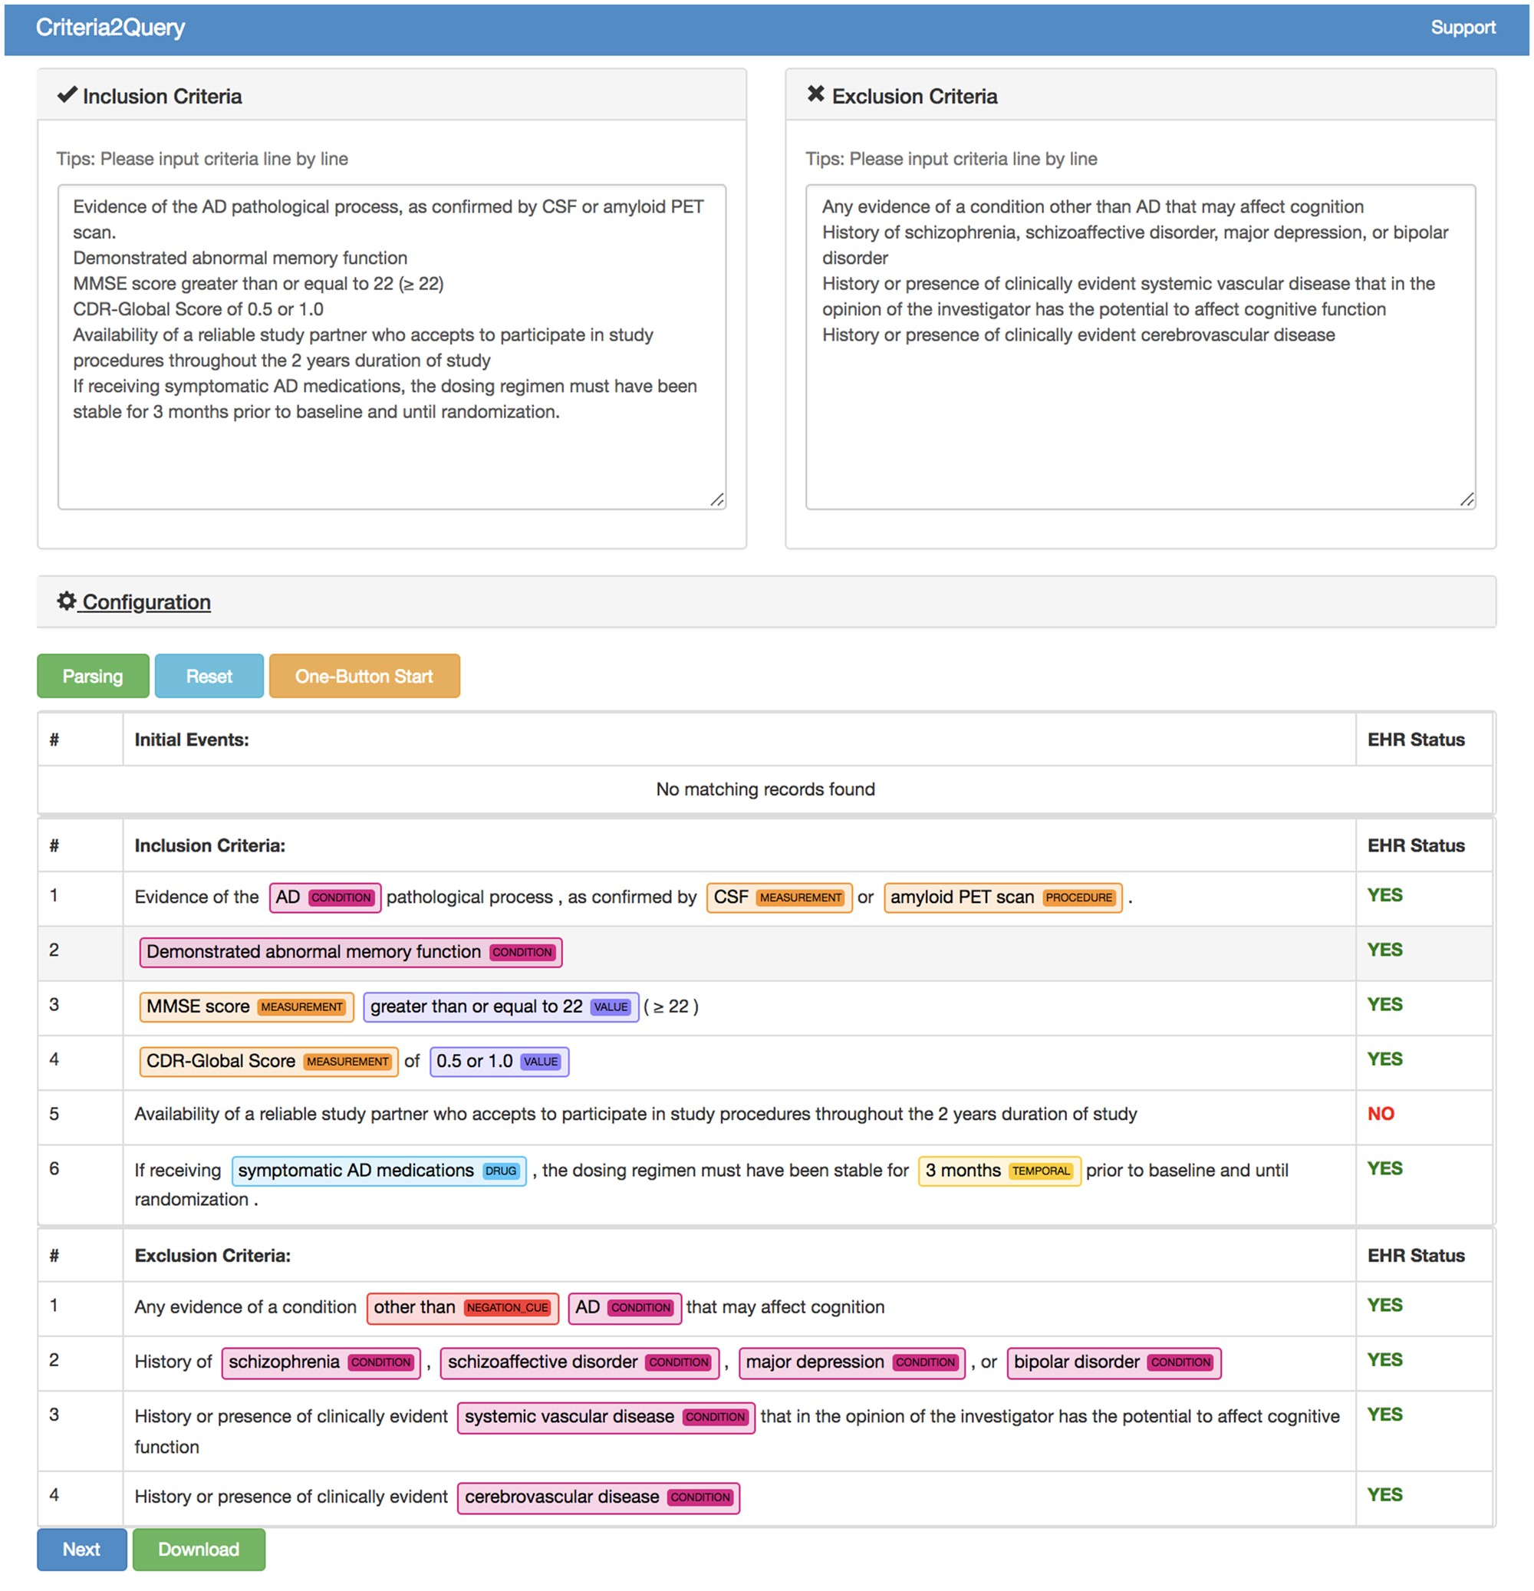
Introduction
Related Work
Clinical Trials Corpus
Query Generation
Web Application
Conclusions
Aim 3 - NLP-based software for cohort discovery
Criteria2Query by Yuan et al. most well known and recent
Hybrid approach: BERT for negation detection and CRF-based classifier for NER, rules for logical composition
Expanded by Fang et al. to allow users to edit predicted criteria
Outputs JSON-based logical representation of criteria to ”Atlas” tool, generates SQL from rules
Sources:
-Yuan, Chi, et al. "Criteria2Query: a natural language interface to clinical databases for cohort definition." Journal of the American Medical Informatics Association 26.4 (2019): 294-305.
-Fang, Yilu, et al. "Combining human and machine intelligence for clinical trial eligibility querying." Journal of the American Medical Informatics Association (2022).

Slide 17
Introduction
Related Work
Clinical Trials Corpus
Query Generation
Web Application
Conclusions
Task Innovation
Aim 1
Our corpus is broad, large, and uniquely granular in phenomena captured
Aim 2
Our methods generalize to virtually any database schema, are capable of reasoning upon non-specific criteria and rival an experienced human programmer in matching cohorts of patients from actual clinical trials
Aim 3
Our system is responsive, user-friendly, intuitive and explainable

Slide 18

Introduction
Related Work
Clinical Trials Corpus
Query Generation
Web Application
Conclusions
Specific Aims
Aim 1
Aim 2
Aim 3
Create a human-annotated gold standard corpus of eligibility criteria.
Develop state-of-the-art NLP-based methods for generating SQL queries for cohort discovery from free-text.
Develop self-service web application for finding patients meeting user-provided free-text eligibility criteria.
“Patients with ...”
SELECT FROM...

Slide 19
Introduction
Related Work
Clinical Trials Corpus
Query Generation
Web Application
Conclusions
Aim 1 – Motivation
Corpus of eligibility criteria which can be used to train predictive models to aid in SQL query generation.
Published in Nature Scientific Data in August 2022.
Sources:
-Dobbins, Nicholas J., et al. "The Leaf Clinical Trials Corpus: a new resource for query generation from clinical trial eligibility criteria." Nature Scientific Data 9.1 (2022): 1-15.

Slide 20
Introduction
Related Work
Clinical Trials Corpus
Query Generation
Web Application
Conclusions
Aim 1 – Corpus Creation
Downloaded 1,020 randomly selected eligibility criteria documents from https://clinicaltrials.gov
Limited to studies
From Jan. 1 2018 onward
50 or more characters in length
20 documents for annotator training, remainder for main annotation task
Named “Leaf Clinical Trials” or “LCT” corpus
Sources:
-Dobbins, Nicholas J., et al. "The Leaf Clinical Trials Corpus: a new resource for query generation from clinical trial eligibility criteria." Nature Scientific Data 9.1 (2022): 1-15.

Slide 21
Introduction
Related Work
Clinical Trials Corpus
Query Generation
Web Application
Conclusions
Aim 1 – Annotation Schema
Aimed to develop expressive, granular, task-oriented annotation schema.
Analyzed previously published corpora
Expanded named entities and relations. For example, added “Contraindication” entity
Not tied to specific database schema
50 total entity types
Categories: Clinical, Demographic, Logical, Qualifier, Temporal & Comparative, Other
51 total relation types
Categories: Alternative & Example, Clinical, Dependent, Logical, Qualifier, Temporal & Comparative, Other

Slide 22
Introduction
Related Work
Clinical Trials Corpus
Query Generation
Web Application
Conclusions
Aim 1 – Annotation Process
2 annotators: 1 biomedical informatician, 1 computer science professor
Met bi-weekly for 3 months
887 single-annotated, 119 double-annotated documents
Inter-annotator agreement by F₁
78.1% for entities, 60.9% for relations by exact character and type matching
Limitations
One annotator annotated 90% of the corpus

Slide 23
Introduction
Related Work
Clinical Trials Corpus
Query Generation
Web Application
Conclusions
Aim 1 – Comparison to other corpora
Measure | EliIE | Chia | LCT Corpus
Disease domain | Alzheimer’s Disease | All | All
# Documents | 230 | 1,000 | 1,006
# Annotations | 15,596 | 68,174 | 105,816
# Entity types | 8 | 15 | 50
# Relation types | 3 | 12 | 51
Mean entities per doc. | - | 46 | 105
Mean relations per doc. | - | 19 | 49

Slide 24
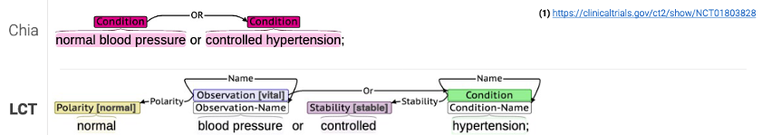
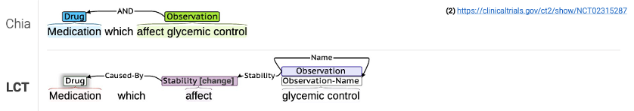
Introduction
Related Work
Clinical Trials Corpus
Query Generation
Web Application
Conclusions
Aim 1 – Comparison to Chia corpus – Examples

Slide 25
Introduction
Related Work
Clinical Trials Corpus
Query Generation
Web Application
Conclusions
Aim 1 – Comparison to Chia corpus – Examples

Slide 26
Introduction
Related Work
Clinical Trials Corpus
Query Generation
Web Application
Conclusions
Aim 1 – Results - Entities
Trained 2 NER models, 1 each for general and fine-grained entities using various architectures
biLSTM+CRF
PubMedBERT (pretrained using PubMed abstracts)
SciBERT (pretrained using biomedical and computer science abstracts)
SciBERT achieved highest overall F₁ of 81%
Architecture | Precision | Recall | F1
biLSTM+CRF | 80% | 79% | 79%
PubMedBERT | 75% | 78% | 77%
SciBERT | 79% | 83% | 81%

Slide 27
Introduction
Related Work
Clinical Trials Corpus
Query Generation
Web Application
Conclusions
Aim 1 – Results - Relations
Trained relation extraction models using
SciBERT
R-BERT + SciBERT (modification of BERT architecture by We & He)
R-BERT + SciBERT achieved highest overall F₁ of 85%
Architecture | Precision | Recall | F1
SciBERT | 80% | 88% | 84%
R-BERT + SciBERT | 82% | 88% | 85%
Sources:
-Wu, S. & He, Y. Enriching pre-trained language model with entity information for relation classification. In Proceedings of the 28th ACM International Conference on Information and Knowledge Management, 2361–2364 (2019).

Slide 28
Introduction
Related Work
Clinical Trials Corpus
Query Generation
Web Application
Conclusions
Aim 1 – Summary
Created Leaf Clinical Trials (LCT) corpus
Highly granular, 50 entity types, 51 relation types
1,006 annotated documents
Best entity F₁ score 81%, relations 85%

Slide 29

Introduction
Related Work
Clinical Trials Corpus
Query Generation
Web Application
Conclusions
Specific Aims
Aim 1
Aim 2
Aim 3
Create a human-annotated gold standard corpus of eligibility criteria.
Develop state-of-the-art NLP-based methods for generating SQL queries for cohort discovery from free-text.
Develop self-service web application for finding patients meeting user-provided free-text eligibility criteria.
“Patients with ...”
SELECT FROM...

Slide 30
Introduction
Related Work
Clinical Trials Corpus
Query Generation
Web Application
Conclusions
Aim 2
Corpus of gold standard eligibility criteria logical forms
Knowledge Base (KB)
Semantic Metadata Mapping (SMM)
Evaluation

Slide 31
Introduction
Related Work
Clinical Trials Corpus
Query Generation
Web Application
Conclusions
Challenges in Query Generation
Query generation originally planned using rules, named entity and relation models from Aim 1
Predicted named entities with relations represented as graph
However, generating queries from graphs is difficult and error-prone
Many, many rules
Difficult to maintain and test
Does not generalize well to new data

Slide 32
Introduction
Related Work
Clinical Trials Corpus
Query Generation
Web Application
Conclusions
Semantic Parsing
Instead: representing as machine readable logical forms disambiguates relations, nesting
Many rules become unnecessary or can be restructured as class/object-specific logic
intersect(
cond(“Diabetic”),
union(
female(),
male()
),
age()
.num_filter(
eq(op(GT), val(“65”))
),
neg(
contraindication(
drug(“metformin”)
)
)
)
“Diabetic women and men aged over 65 with no contraindications to metformin”

Slide 33
Introduction
Related Work
Clinical Trials Corpus
Query Generation
Web Application
Conclusions
Semantic Parsing
1 2 3 4
Instead: representing as machine readable logical forms disambiguates relations, nesting
Many rules become unnecessary or can be restructured as class/object-specific logic
intersect(
cond(“Diabetic”),
union(
female(),
male()
),
age()
.num_filter(
eq(op(GT), val(“65”))
),
neg(
contraindication(
drug(“metformin”)
)
)
)
“Diabetic women and men aged over 65 with no contraindications to metformin”

Slide 34
Introduction
Related Work
Clinical Trials Corpus
Query Generation
Web Application
Conclusions
Leaf Logical Forms Corpus Creation
Randomly selected 2,000 lines of eligibility criteria from the LCT corpus
~30% of lines (600) rare or complex entity/relation types (If-Then, Before/After, Contraindication, etc.)
Remaining ~70% random
Called “Leaf Logical Forms” or “LLF” corpus

Slide 35
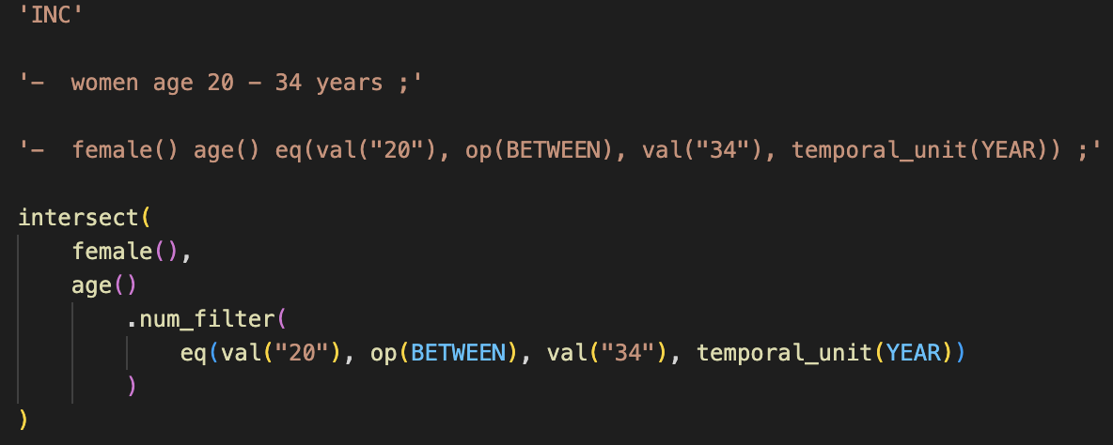
Introduction
Related Work
Clinical Trials Corpus
Query Generation
Web Application
Conclusions
Logical Forms Corpus Creation (cont.)
Each eligibility criteria line saved as a JavaScript file of format:
Inclusion or Exclusion
Original text
Augmented text
Logical Form human annotation

Slide 36
Introduction
Related Work
Clinical Trials Corpus
Query Generation
Web Application
Conclusions
Logical Forms Corpus – Annotation Process
3 annotators: all UW PhD students, 2 in BIME, 1 in Information School
Met weekly for 2 months
Resulting corpus 1,980 single-annotated, 20 triple-annotated files
Inter-annotator agreement by BLEU: 82.4%
Annotators | BLEU Score (%)
Annotator 1 / Annotator 2 | 86.6
Annotator 1 / Annotator 3 | 79.5
Annotator 2 / Annotator 3 | 81.0
Mean | 82.4

Slide 37
Introduction
Related Work
Clinical Trials Corpus
Query Generation
Web Application
Conclusions
LLF Corpus– Results
Syntax Style | Example Input | Example Output | BLEU
Raw Text | Diabetics who smoke | intersect( cond(“Diabetics”), obs(“smoke”) ) | 78.7
Augmented Text | cond(“Diabetics”) who obs(“smoke”) | intersect( cond(“Diabetics”), obs(“smoke”) ) | 93.5
Pointer | cond(@1) who obs(@2) | intersect( cond(@1), obs(@2) ) | 93.3
Shift-Reduce | [cond “Diabetics” cond] who [obs “smoke” obs] | [intersect [cond “Diabetics” cond] [obs “smoke” obs] intersect] | 89.8
Shift-Reduce+ Pointer | [cond @1 cond] who [obs @2 obs] | [intersect [cond @1 cond] [obs @2 obs] intersect] | 89.4
Random 70/20/10 train/test/dev split of corpus
Experiments used ”T5” architecture and pretrained model for various Seq2Seq tasks
Tried other syntax styles as well from literature
”Shift-Reduce”
“Pointer”
Replacing raw spans with named entity logical forms improved by +14.7%

Slide 38
Introduction
Related Work
Clinical Trials Corpus
Query Generation
Web Application
Conclusions
LLF Corpus– Results
Syntax Style | Example Input | Example Output | BLEU
Raw Text | Diabetics who smoke | intersect( cond(“Diabetics”), obs(“smoke”) ) | 78.7
Augmented Text | cond(“Diabetics”) who obs(“smoke”) | intersect( cond(“Diabetics”), obs(“smoke”) ) | 93.5
Pointer | cond(@1) who obs(@2) | intersect( cond(@1), obs(@2) ) | 93.3
Shift-Reduce | [cond “Diabetics” cond] who [obs “smoke” obs] | [intersect [cond “Diabetics” cond] [obs “smoke” obs] intersect] | 89.8
Shift-Reduce+ Pointer | [cond @1 cond] who [obs @2 obs] | [intersect [cond @1 cond] [obs @2 obs] intersect] | 89.4
Random 70/20/10 train/test/dev split of corpus
Experiments used ”T5” architecture and pretrained model for various Seq2Seq tasks
Tried other syntax styles as well from literature
”Shift-Reduce”
“Pointer”
Replacing raw spans with named entity logical forms improved by +14.7%

Slide 39
Introduction
Related Work
Clinical Trials Corpus
Query Generation
Web Application
Conclusions
Aim 2
Corpus of gold standard eligibility criteria logical forms
Knowledge Base (KB)
Semantic Metadata Mapping (SMM)
Evaluation

Slide 40
Introduction
Related Work
Clinical Trials Corpus
Query Generation
Web Application
Conclusions
Knowledge Base
Built using RDF, or Resource Description Framework graph database of triples query-able by SPARQL
Core is the UMLS
Also
LOINC2HPO (for Lab Result -> Condition reasoning)
Disease Ontology
Symptom Ontology
Potential Drug-Drug Interactions
COVID-19 Ontology
Knowledge Base
LOINC2HPO
RDF + SPARQL
Disease Ontology
Symptom Ontology
UMLS
COVID-19 Ontology
Potential Drug-Drug Interactions (PDDI)
Sources:
-L. M. Schriml, C. Arze, S. Nadendla, Y.-W. W. Chang, M. Mazaitis, V. Felix, G. Feng, and W. A. Kibbe. Disease Ontology: a backbone for disease semantic integration. Nucleic acids research, 40(D1):D940–D946, 2012.
-A. Sargsyan, A. T. Kodamullil, S. Baksi, J. Darms, S. Madan, S. Gebel, O. Keminer, G. M. Jose, H. Balabin, L. N. DeLong, et al. The COVID-19 ontology. Bioinformatics, 36(24):5703–5705, 2020.
-S. Ayvaz, J. Horn, O. Hassanzadeh, Q. Zhu, J. Stan, N. P. Tatonetti, S. Vilar, M. Brochhausen, M. Samwald, M. Rastegar-Mojarad, et al. Toward a complete dataset of drug–drug interaction information from publicly available sources. Journal of biomedical informatics, 55:206–217, 2015.
-X. A. Zhang, A. Yates, N. Vasilevsky, J. Gourdine, T. J. Callahan, L. C. Carmody, D. Danis, M. P. Joachimiak, V. Ravanmehr, E. R. Pfaff, et al. Semantic integration of clinical laboratory tests from electronic health records for deep phenotyping and biomarker discovery. NPJ digital medicine, 2(1):1–9, 2019.

Slide 41
Introduction
Related Work
Clinical Trials Corpus
Query Generation
Web Application
Conclusions
Multi-hop Reasoning
”Contraindications to drugs for conditions which affect respiration”
contraindication(
drug()
.for(
obs(“respiration”)
.change()
.caused_by(
cond()
)
)
)

Slide 42
Introduction
Related Work
Clinical Trials Corpus
Query Generation
Web Application
Conclusions
Multi-hop Reasoning
”Contraindications to drugs for conditions which affect respiration”
contraindication(
drug()
.for(
obs(“respiration”)
.change()
.caused_by(
cond()
)
)
)
1
Asthma causes changes to respiration

Slide 43
Introduction
Related Work
Clinical Trials Corpus
Query Generation
Web Application
Conclusions
Multi-hop Reasoning
”Contraindications to drugs for conditions which affect respiration”
contraindication(
drug()
.for(
obs(“respiration”)
.change()
.caused_by(
cond()
)
)
)
2
Methylprednisolone can be used to treat asthma
1
Asthma causes changes to respiration

Slide 44
Introduction
Related Work
Clinical Trials Corpus
Query Generation
Web Application
Conclusions
Multi-hop Reasoning
”Contraindications to drugs for conditions which affect respiration”
contraindication(
drug()
.for(
obs(“respiration”)
.change()
.caused_by(
cond()
)
)
)
Mycosis (fungal infection) is a contraindication to methylprednisolone
3
2
Methylprednisolone can be used to treat asthma
1
Asthma causes changes to respiration

Slide 45
Introduction
Related Work
Clinical Trials Corpus
Query Generation
Web Application
Conclusions
Aim 2
Corpus of gold standard eligibility criteria logical forms
Knowledge Base (KB)
Semantic Metadata Mapping (SMM)
Evaluation

Slide 46
Introduction
Related Work
Clinical Trials Corpus
Query Generation
Web Application
Conclusions
Semantic Metadata Mapping
C0421451 “Female”
WHERE gender=‘F’
C0086582 “Male”
WHERE gender=‘M’
C3887376 “Genderqueer”
WHERE gender=‘GQ’
Map logical forms to a ”Semantic Metadata Mapping”:
Machine-readable “tagging” system for mapping database objects and records to their meaning and usage
Small pre-defined subset of UMLS concepts
C5236161 “Patient Identifier”
C0421451
“Date of Birth”
person_id | birthdate | gender
1 | 1-1-2000 | F
2 | 2-2-1980 | M
3 | 3-3-1970 | F
UMLS Concept or Source Coding System

Slide 47
Introduction
Related Work
Clinical Trials Corpus
Query Generation
Web Application
Conclusions
Semantic Metadata Mapping
C0001779 “Patient age”
age(C0001779)
current_age
Coding System: ICD-10
WHERE dx_coding_system=‘I10’
cond(C0241863 “Diabetic”)
dx_code
Coding System: ICD-10 E08-E13

Slide 48
Introduction
Related Work
Clinical Trials Corpus
Query Generation
Web Application
Conclusions
LeafAI - System Overview

Slide 49
Introduction
Related Work
Clinical Trials Corpus
Query Generation
Web Application
Conclusions
Aim 2
Corpus of gold standard eligibility criteria logical forms
Knowledge Base (KB)
Semantic Metadata Mapping (SMM)
Evaluation

Slide 50
Introduction
Related Work
Clinical Trials Corpus
Query Generation
Web Application
Conclusions
Aim 2 – Evaluation
Extracted metadata on 168 clinical trials at UW between Jan. 2017 and Dec. 2021
At least 10 patients enrolled
Number of raw lines of eligibility criteria file <= 30
Grouped trials by “condition” field, 7 conditions of interest
Randomly chose 1 trial per condition (except cancer, where 2 chosen), 8 total
Generated SQL queries using LeafAI and human programmer
Data time-limited by trial, used OMOP database
Human instructed to
Skip criterion which cannot be computed
Reason about non-specific criteria where possible (e.g., symptoms, contraindications)
Both LeafAI and human skipped criteria where zero patients found

Slide 51
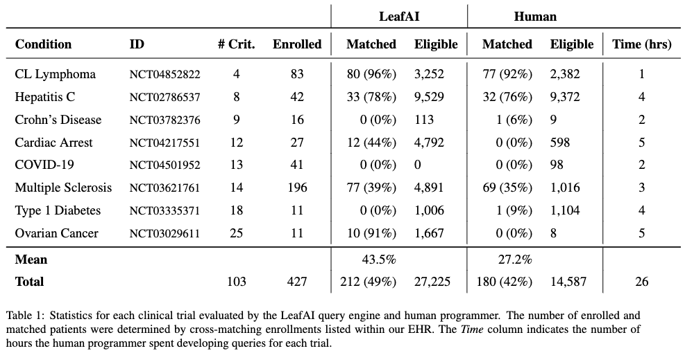
Introduction
Related Work
Clinical Trials Corpus
Query Generation
Web Application
Conclusions
Aim 2 –Results
LeafAI matched 43% of patients compared to 27% by human programmer across 8 trials
Zero patients matched in 3/8 trials
LeafAI found 27,225 eligible versus 14,587 eligible by human programmer
Human spent 26 hours, LeafAI several minutes

Slide 52
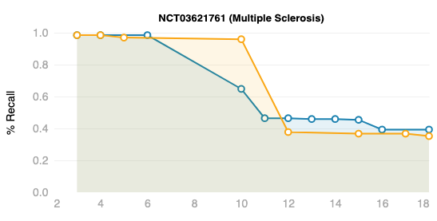
Introduction
Related Work
Clinical Trials Corpus
Query Generation
Web Application
Conclusions
Aim 2 – Results
Exclusion: “Current shift work sleep disorder, or narcolepsy diagnosed with polysomnography and multiple sleep latency test”
LeafAI excluded patients with drowsiness, snoring, etc.
Exclusion: “Current stimulant or wake-promoting agent use (such as amantadine, modafinil, methylphenidate, or amphetamine) within 30 days of screening”
LeafAI
Human
Many patients had orders for stimulants over course of trial.

Slide 53
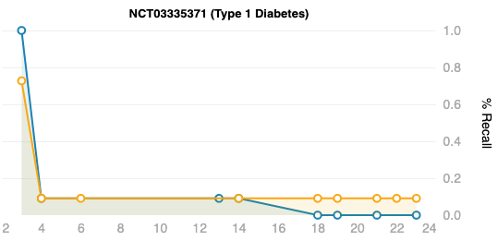
Introduction
Related Work
Clinical Trials Corpus
Query Generation
Web Application
Conclusions
Aim 2 – Results
“People diagnosed with T1DM, confirmed diagnosis prior to 40 years of age and a diagnosed for minimum of 1 year.”
Human queried A1c > 6.5%, LeafAI used diagnosis codes.
LeafAI
“Type 1 diabetics using either continuous subcutaneous insulin infusion (with lispro or aspart) or multiple daily doses of insulin”
Human
Few patients had insulin orders (in our data).

Slide 54
Introduction
Related Work
Clinical Trials Corpus
Query Generation
Web Application
Conclusions
Discussion
“Missing” structured data very challenging, causes false negatives
Affects both human and LeafAI
Processing unstructured data (in future) may help
LeafAI Knowledge Base (KB) a double-edged sword
✓ Casts wide net, slightly higher recall
⨯ Can cause unnecessary exclusions
e.g., snoring “is-a” sleep disorder
Need for human-in-the-loop review
Human programmer may have higher precision
We don’t know # of truly eligible patients
OMOP DB did not contain entirety of EHR data

Slide 55
Introduction
Related Work
Clinical Trials Corpus
Query Generation
Web Application
Conclusions
Aim 2 – Summary
Leaf Logical Form (LLF) corpus
Eligibility criteria logical forms; Validation BLEU score 93.5%
Knowledge Base (KB)
Reasoning on non-specific criteria; Incorporated numerous sources in graph database
Semantic Metadata Mapping (SMM)
UMLS-based tagging system for model-agnostic query generation
Evaluated using 8 UW clinical trials
Matching patients in 5/8 trials
Mean 43% recall, human programmer 27%

Slide 56
Introduction
Related Work
Clinical Trials Corpus
Query Generation
Web Application
Conclusions
Specific Aims
Aim 1
Aim 2
Aim 3
Create a human-annotated gold standard corpus of eligibility criteria.
Develop state-of-the-art NLP-based methods for generating SQL queries for cohort discovery from free-text.
Develop self-service web application for finding patients meeting user-provided free-text eligibility criteria.
“Patients with ...”
SELECT FROM...

Slide 57
Introduction
Related Work
Clinical Trials Corpus
Query Generation
Web Application
Conclusions
Aim 3 – Motivation
Self-service cohort discovery from free text
User interface
Accessible user action history with chat-like interface
Previous actions and responses preserved above ↑
New inputs inserted below ↓
Explainability of system actions
Rapid feedback, responsiveness from system
Iterative exploration and editable system responses by multimodal input
User evaluation will be future work
Comprehensive study using existing large Leaf user base needed

Slide 58
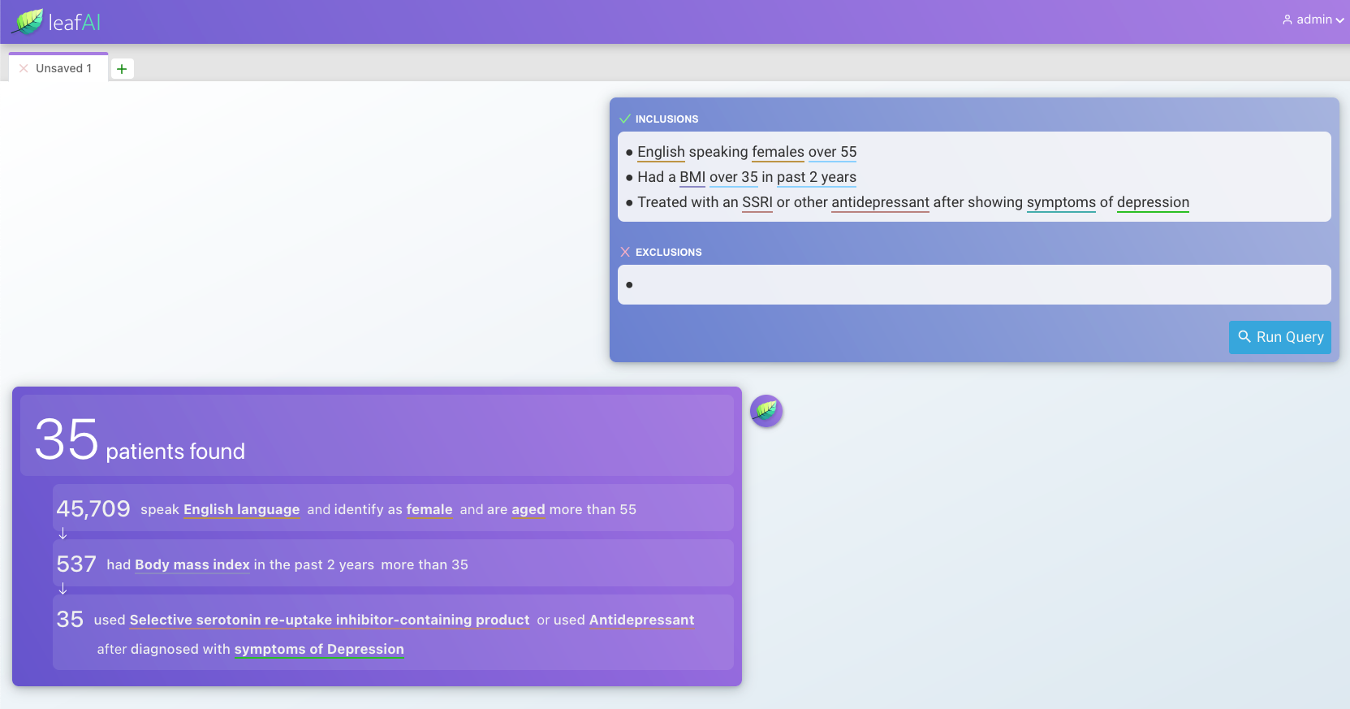
Introduction
Related Work
Clinical Trials Corpus
Query Generation
Web Application
Conclusions
User input
System response

Slide 59
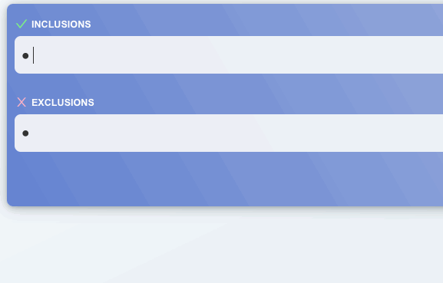
Introduction
Related Work
Clinical Trials Corpus
Query Generation
Web Application
Conclusions
Aim 3 – Goals - Explainability
If user writes eligibility criteria but does not know if misunderstood until after queries executed:
Wasted time if query fails
Uncertainty, lack of trust in system
System performs NER and normalization as user types criteria

Slide 60
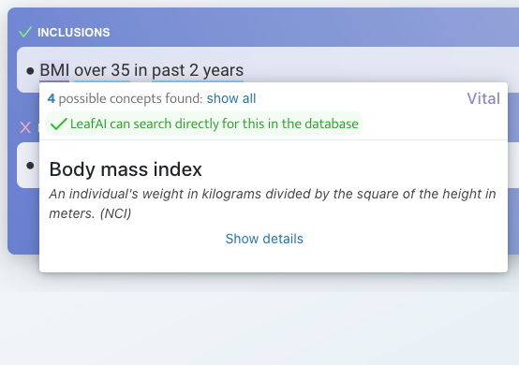
Introduction
Related Work
Clinical Trials Corpus
Query Generation
Web Application
Conclusions
Aim 3 – Goals - Explainability
If user writes eligibility criteria but does not know if misunderstood until after queries executed:
Wasted time if query fails
Uncertainty, lack of trust in system
System performs NER and normalization as user types criteria
Normalization Success

Slide 61
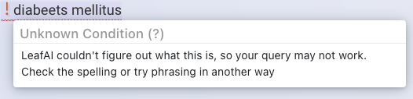
Introduction
Related Work
Clinical Trials Corpus
Query Generation
Web Application
Conclusions
Aim 3 – Goals - Explainability
If user writes eligibility criteria but does not know if misunderstood until after queries executed:
Wasted time if query fails
Uncertainty, lack of trust in system
System performs NER and normalization as user types criteria
Normalization Failure

Slide 62
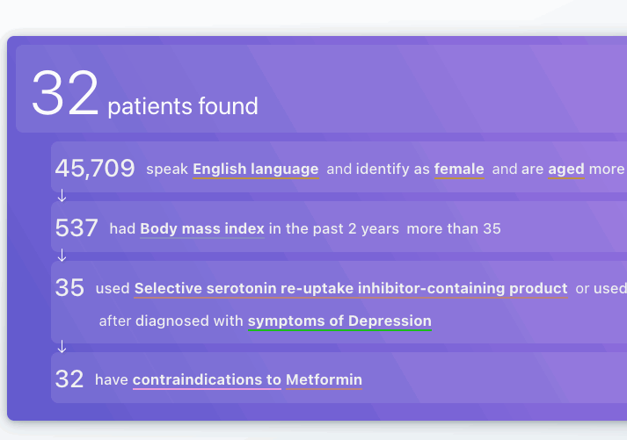
Introduction
Related Work
Clinical Trials Corpus
Query Generation
Web Application
Conclusions
Aim 3 – Goals – Explainability (cont.)
After query results returned, query inputs can be
Viewed and edited directly
Re-executed
Reasoned concepts can be enabled / disabled

Slide 63
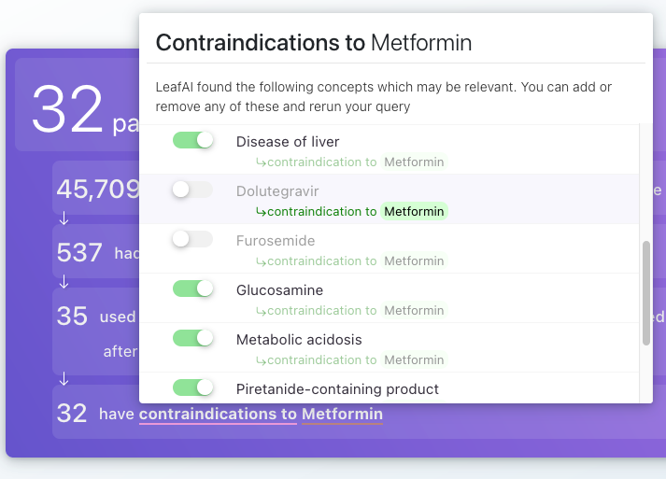
Introduction
Related Work
Clinical Trials Corpus
Query Generation
Web Application
Conclusions
Aim 3 – Goals – Explainability (cont.)
After query results returned, query inputs can be
Viewed and edited directly
Re-executed
Reasoned concepts can be enabled / disabled

Slide 64
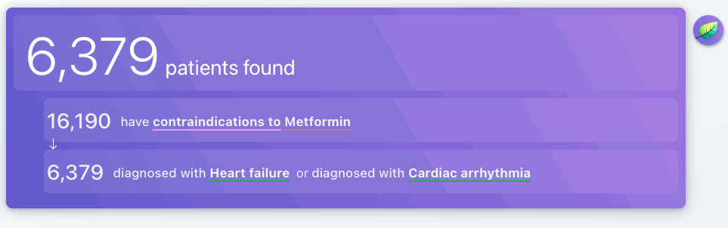
Introduction
Related Work
Clinical Trials Corpus
Query Generation
Web Application
Conclusions
Aim 3 – Goals – Explainability (cont.)
After query results returned, query inputs can be
Viewed and edited directly
Re-executed
Reasoned concepts can be enabled / disabled

Slide 65
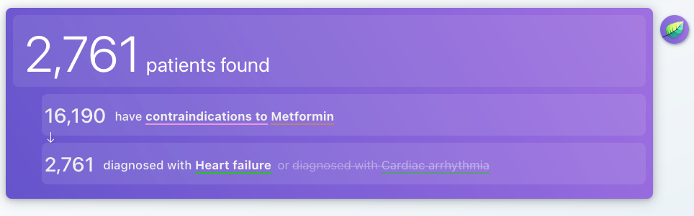
Introduction
Related Work
Clinical Trials Corpus
Query Generation
Web Application
Conclusions
Aim 3 – Goals – Explainability (cont.)
After query results returned, query inputs can be
Viewed and edited directly
Re-executed
Reasoned concepts can be enabled / disabled

Slide 66
Introduction
Related Work
Clinical Trials Corpus
Query Generation
Web Application
Conclusions
Aim 3 – Goals – Rapid feedback / Responsiveness
Bi-directional streaming interfaces between client and server.
Enables server to update client as to progress incrementally.

Slide 67
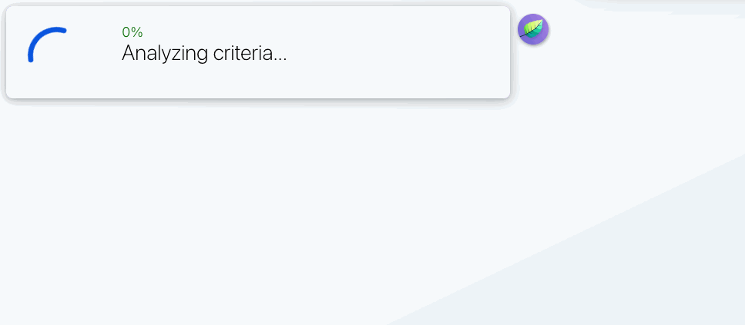
Introduction
Related Work
Clinical Trials Corpus
Query Generation
Web Application
Conclusions
Aim 3 – Goals – Rapid feedback / Responsiveness
Each line of criteria executed as individual SQL statements
Streaming interfaces enable client to be updated incrementally in real-time
Example query generation and execution (11 seconds)

Slide 68
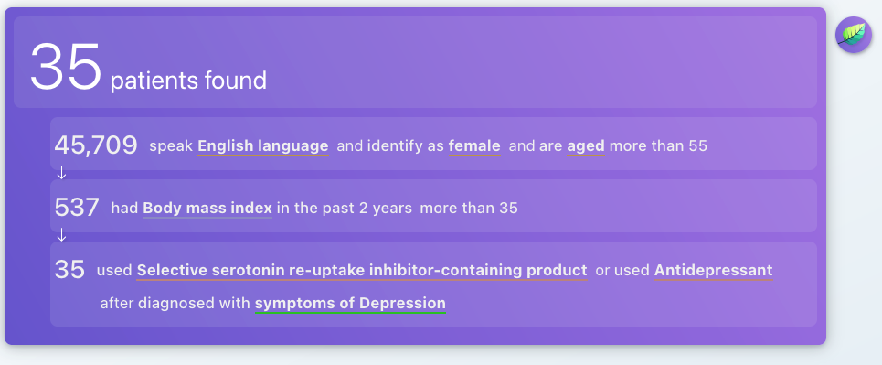
Introduction
Related Work
Clinical Trials Corpus
Query Generation
Web Application
Conclusions
Aim 3 – Goals – Rapid feedback / Responsiveness
Each line of criteria executed as individual SQL statements
Streaming interfaces enable client to be updated incrementally in real-time
Example query generation and execution (11 seconds total)

Slide 69
Introduction
Related Work
Clinical Trials Corpus
Query Generation
Web Application
Conclusions
Aim 3 –Goals – Iterative exploration
User edits criteria based on results
Enabling user to directly edit previous query results
Saves time
Faster iteration, exploration
Transparency
Build user trust, confidence in system
... have diagnosis of diabetes or A1c over 6.5%
... are over 18 30 years old
LeafAI responds with results
5,422 patients found
-6,149 have diagnosis of diabetes
-5,422 are over 18 years old
LeafAI responds with updated results
6,629 patients found
-7,587 have diagnosis of diabetes or A1c over 6.5%
-6,629 are over 30 years old
User provides initial criteria
-Have diagnosis of diabetes -Are over 18 years old

Slide 70
Introduction
Related Work
Clinical Trials Corpus
Query Generation
Web Application
Conclusions
Summary & Contributions
Aim 1
LCT corpus is broad and uniquely granular in phenomena captured
Aim 2
LLF corpus unique in representing eligibility criteria as logical forms
Our methods generalize to virtually any database schema
Capable of reasoning upon non-specific criteria
Rivals an experienced human programmer in matching patients from actual clinical trials
Aim 3
Our system is responsive, user-friendly and explainable
Queries are editable, re-executable in multi-modal input fashion

Slide 71
Introduction
Related Work
Clinical Trials Corpus
Query Generation
Web Application
Conclusions
Project Limitations
Both LCT and LLF corpora
Annotated by non-clinicians
Largely single-annotated
Clinical trials evaluated only a small sample of all clinical trials, selected for only certain diseases and of shorter number of criteria
OMOP database is subset of data within EHR
Certain queries and data likely cannot be handled by our system
Use structured data only (i.e., no text clinical notes)
As each criteria line processed individually, system fails in cases of multi-line coreferences. However,
Somewhat rare; only 78 coreference annotations in LCT corpus

Slide 72
Introduction
Related Work
Clinical Trials Corpus
Query Generation
Web Application
Conclusions
Future Work
LeafAI web application user acceptance testing
Benchmarking and experimentation with GPT-4 for query generation
May also be useful for adding general purpose question-answering capabilities
Development of de-identified open dataset (with DUA) of patients with clinical data & human-reviewed clinical trials eligibility for researchers
May serve as gold standard for eligibility prediction
Further exploration of multi-modal input & output with large language models

Slide 73
Introduction
Related Work
Clinical Trials Corpus
Query Generation
Web Application
Conclusions
Future Work
LeafAI web application user acceptance testing
Benchmarking and experimentation with GPT-4 for query generation
May also be useful for adding general purpose question-answering capabilities
Development of de-identified open dataset (with DUA) of patients with clinical data & human-reviewed clinical trials eligibility for researchers
May serve as gold standard for eligibility prediction
Further exploration of multi-modal input & output with large language models

Slide 74
Introduction
Related Work
Clinical Trials Corpus
Query Generation
Web Application
Conclusions
Future Work
LeafAI web application user acceptance testing
Benchmarking and experimentation with GPT-4 for query generation
May also be useful for adding general purpose question-answering capabilities
Development of de-identified open dataset (with DUA) of patients with clinical data & human-reviewed clinical trials eligibility for researchers
May serve as gold standard for eligibility prediction
Further exploration of multi-modal input & output with large language models

Slide 75
Introduction
Related Work
Clinical Trials Corpus
Query Generation
Web Application
Conclusions
Future Work
LeafAI web application user acceptance testing
Benchmarking and experimentation with GPT-4 for query generation
May also be useful for adding general purpose question-answering capabilities
Development of de-identified open dataset (with DUA) of patients with clinical data & human-reviewed clinical trials eligibility for researchers
May serve as gold standard for eligibility prediction
Further exploration of multi-modal input & output with large language models

Slide 76
Introduction
Related Work
Clinical Trials Corpus
Query Generation
Web Application
Conclusions
Relevant First or Co-First Authored Work
Dobbins NJ, Han B, Zhou W, Lan K, Kim H N, Harrington R, Uzuner Ö, Yetisgen M. LeafAI: query generator for clinical cohort discovery rivaling a human programmer. (in review)
Dobbins, NJ, Mullen, T., Uzuner, Ö., & Yetisgen, M. (2022). The Leaf Clinical Trials Corpus: a new resource for query generation from clinical trial eligibility criteria. Nature Scientific Data, 9(1), 1-15.
Lybarger K, Dobbins NJ, Long R, Singh A, Wedgeworth P, Uzuner Ö, Yetisgen M. (2023) Leveraging natural language processing to augment structured social determinants of health data in the electronic health record. J Am Med Inform Assoc. ocad073.
Lee, K., Dobbins, NJ, McInnes, B., Yetisgen, M., & Uzuner, Ö. (2021). Transferability of neural network clinical deidentification systems. J Am Med Inform Assoc, 28(12), 2661-2669.
Dobbins, NJ, Spital, C. H., Black, R. A., Morrison, J. M., De Veer, B., Zampino, E., ... & Mooney, S. D. (2020). Leaf: an open-source, model-agnostic, data-driven web application for cohort discovery and translational biomedical research. J Am Med Inform Assoc, 27(1), 109-118.
Dissertation

Slide 77
Introduction
Related Work
Clinical Trials Corpus
Query Generation
Web Application
Conclusions
Acknowledgements
My Committee Members
Meliha Yetisgen
Nina Kim
Trevor Cohen
Fei Xia
Annotators and Collaborators
Tony Mullen
Bin Han
Weipeng Zhou
Supporting Faculty
Sean Mooney
Peter Tarczy-Hornoch
Database Programmer
Kristine Lan
Organizations
UW
UWM Research IT
ITHS
My family

Slide 78
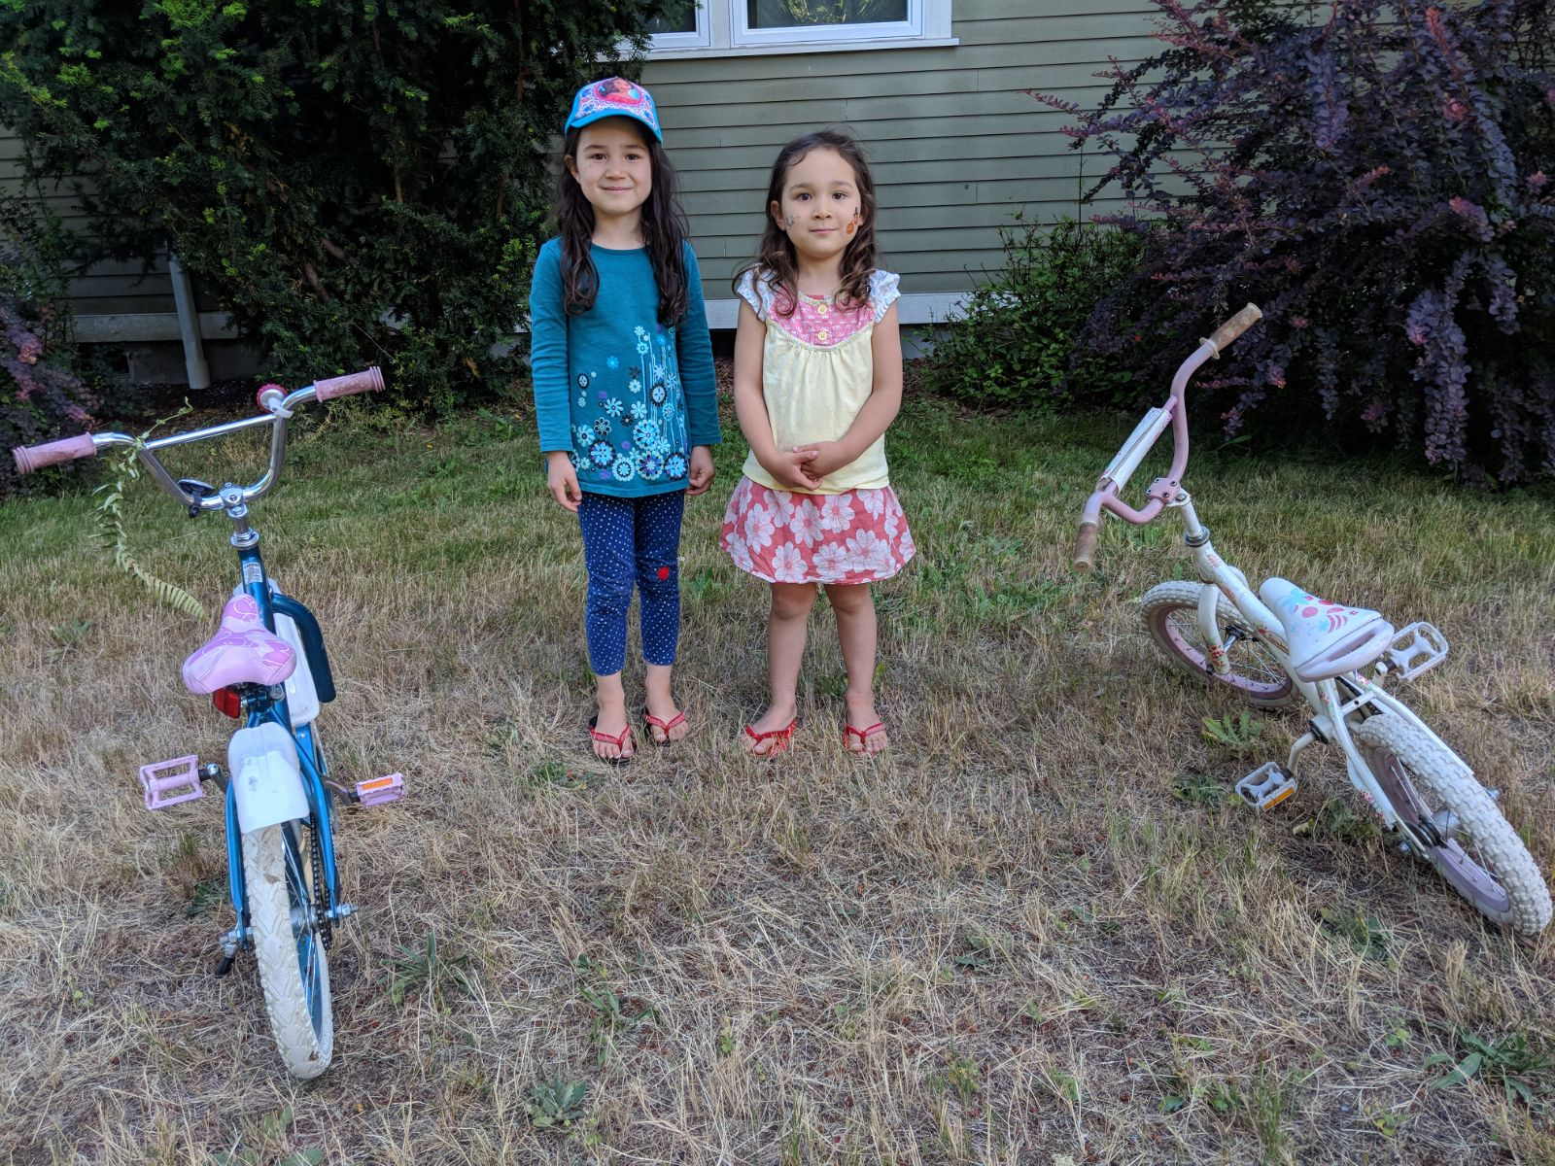
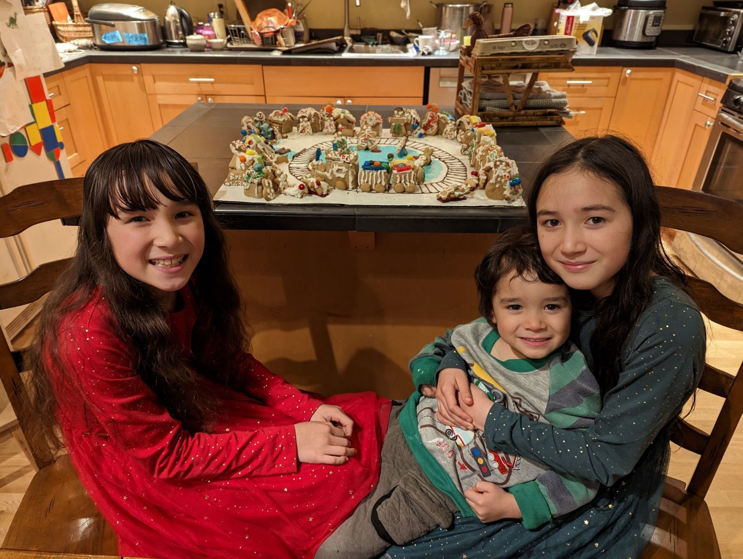
Introduction
Related Work
Clinical Trials Corpus
Query Generation
Web Application
Conclusions
2018
~2023

Slide 79
Introduction
Related Work
Clinical Trials Corpus
Query Generation
Web Application
Conclusions
Thank you! Questions?

Slide 80
Introduction
Related Work
Clinical Trials Corpus
Query Generation
Web Application
Conclusions
Appendix

Slide 81
Aim 2 – Process – Steps 1,2
Named Entity Recognition (NER) using BERT and Relation Extraction using R-BERT.
Or
Numeric-Filter
“- Diabetic women and men aged over 65 with no contraindications to metformin”
Condition
Female
Male
Age
Eq-Comparison
-
Diabetic
women
and
men
aged
over 65
Operator: Greater Value: “65”
Negates
Contraindicates
Negation
Contraindication
Drug
with
no
contraindications
to
metformin
Named Entity Recognition
Relation Extraction
BERT
R-BERT
Python
Python

Slide 82
Aim 2 – Process – Steps 2,3
Transform to logical form prediction input string, replacing raw text named entities values with named entities names and removing any hypothetical events.
Or
Numeric-Filter
“- Diabetic women and men aged over 65 with no contraindications to metformin”
“- cond(“Diabetic”) female() and male()
age() eq(op(GT), val(“65”))
with neg() contraindication() to
drug(“metformin”)”
Condition
Female
Male
Age
Eq-Comparison
-
Diabetic
women
and
men
aged
over 65
Operator: Greater Value: “65”
Negates
Contraindicates
Negation
Contraindication
Drug
with
no
contraindications
to
metformin

Slide 83
Aim 2 – Process – Steps 4,5
Predict structured logical form using fine-tuned T5 model, output as a string. Then, parse logical forms and instantiate as in-memory nested object structure.
intersect(
,
union(
,
),
.num_filter(
),
(
(
)
)
)
“-
cond(“Diabetic”)
“-
cond(“Diabetic”)
female()
and
female()
and
age()
male()
age()
eq(op(GT), val(“65”))
male()
eq(op(GT), val(“65”))
()
neg
()
with
neg
()
contraindication
with
()
contraindication
to
to
”
drug(“metformin”)
”
drug(“metformin”)
Logical Form Transformation
T5
Python

Slide 84
Aim 2 – Process – Step 6
Normalize to UMLS concepts using MetaMapLite and BERT (the latter only in the case of lab tests).
intersect(
cond(“Diabetic”),
union(
female(),
male()
),
age()
.num_filter(
eq(op(GT), val(“65”))
),
neg(
contraindication(
drug(“metformin”)
)
)
)
intersect(
cond(C0241863 “Diabetic”),
union(
female(),
male()
),
age()
.num_filter(
eq(op(GT), val(“65”))
),
neg(
contraindication(
drug(C0025598 “metformin”)
)
)
)
Normalization
MetaMapLite
BERT (Labs)
Java
Python

Slide 85
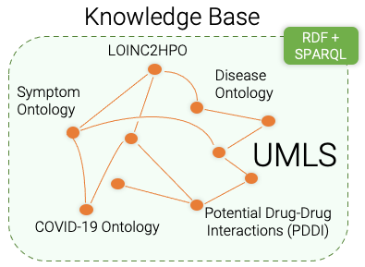
Aim 2 – Process – Steps 7,8
Reason using Knowledge Base to determine: contraindications, indications, risk factors, signs / symptoms, unspecified criteria.
intersect(
cond(C0241863 “Diabetic”),
union(
female(),
male()
),
age()
.num_filter(
eq(op(GT), val(“65”))
),
neg(
contraindication(
drug(C0025598 “metformin”)
)
)
)
intersect(
cond(CUI: C0241863 “Diabetic”),
union(
female(),
male()
),
age()
.num_filter(
eq(op(GT), val(“65”))
),
neg(
cond(C0220981 “Metabolic acidosis”),
drug(C3253985 “Dolutegravir”)
)
)

Slide 86
Aim 2 – Process – Step 9
Link to the Semantic Metadata Mapping to generate SQL statements.
Semantic Metadata Map
Logical forms
{
name: ”person”
columns:
{
name: “sex”
semantic_mappings:
C0086287 where sex = “F”
C0086582 where sex = “M”
}
{
name: “age”,
semantic_mappings: C0001779
}
{
name: “conditions”
columns:
{
name: “condition_code”
code_mappings:
ICD10 where code_source = “I10”
}
{
name: “code_source”
}
}
intersect(
C0241863, SAB: ICD10...
union(
C0086287,
C0086582,
),
C0001779
.num_filter(
eq(op(GT), val(“65”))
),
neg(
C0220981, SAB: ICD10...,
C3253985, SAB: RxNorm...
)
)
intersect(
cond(“Diabetic”),
union(
female(),
male()
),
age()
.num_filter(
eq(op(GT), val(“65”))
),
neg(
contraindication(
drug(“metformin”)
)
)
)
Semantic Metadata Mapping

Slide 87
Aim 2 – Process – Step 9
Use mapped database schema paired with logical forms to generate SQL statements using rules.
intersect(
C0241863 “condition_code”
union(
C0086287 “sex = ‘F’”,
C0086582 “sex = ‘M’”,
),
C0001779 “age”
.num_filter(
eq(op(GT), val(“65”))
),
neg(
C0220981 “condition_code”,
C3253985 “drug_code”
)
)
SELECT person_id FROM condition ...
INTERSECT
SELECT person_id FROM (
SELECT person_id FROM person
WHERE sex = ‘F’
UNION
SELECT person_id FROM person
WHERE sex = ‘M’
)
INTERSECT
SELECT person_id FROM person
WHERE age > 65
INTERSECT
SELECT person_id FROM person
WHERE NOT EXISTS...
SQL Generation

Slide 88
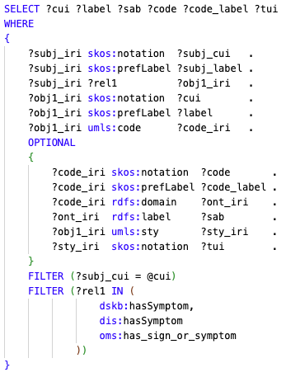
Introduction
Related Work
Clinical Trials Corpus
Query Generation
Web Application
Conclusions
Knowledge Base - SPARQL
Accessible using SPARQL graph queries for
Treatments for conditions
Contraindications to drugs or procedures
Signs and symptoms of conditions
Risks for conditions
Indications for drugs
Each SPARQL query
Created by hand
Parameterized by CUIs
Depressive disorder C0011581
Agitation C0085631
Insomnia C0917801
Homelessness C0019863
….

Slide 89
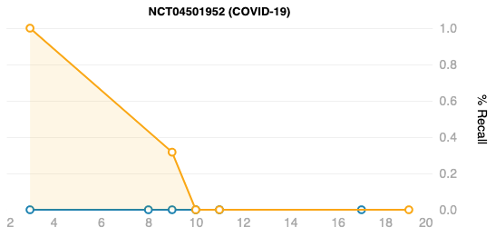
Introduction
Related Work
Clinical Trials Corpus
Query Generation
Web Application
Conclusions
Aim 2 – Results
“Willing and able to provide written informed consent, (individuals ≥ 18 years of age) or assent (individuals ≥ 12 and < 18 years of age) prior to performing study procedures. Individuals age ≥ 18 years may be enrolled with the consent of a legal representative where permitted according to local law and approved nationally and by the relevant institutional review board (IRB) or independent ethics committee (IEC). For individuals ≥ 12 and < 18 years of age, a parent or legal guardian must be willing and able to provide written informed consent prior to performing study procedures”
LeafAI
Human
“Severe acute respiratory syndrome (SARS)-coronavirus (CoV)-2 infection confirmed by molecular diagnosis (nucleic acid (polymerase chain reaction (PCR) or antigen testing) ≤ 4 days prior to screening”
“Presence of ≥ 1 symptom(s) consistent with COVID-19 for ≤ 7 days prior to randomization”
Some patients had no PCR test (in our data). Others had no symptoms as diagnosis codes.

